Slide 1
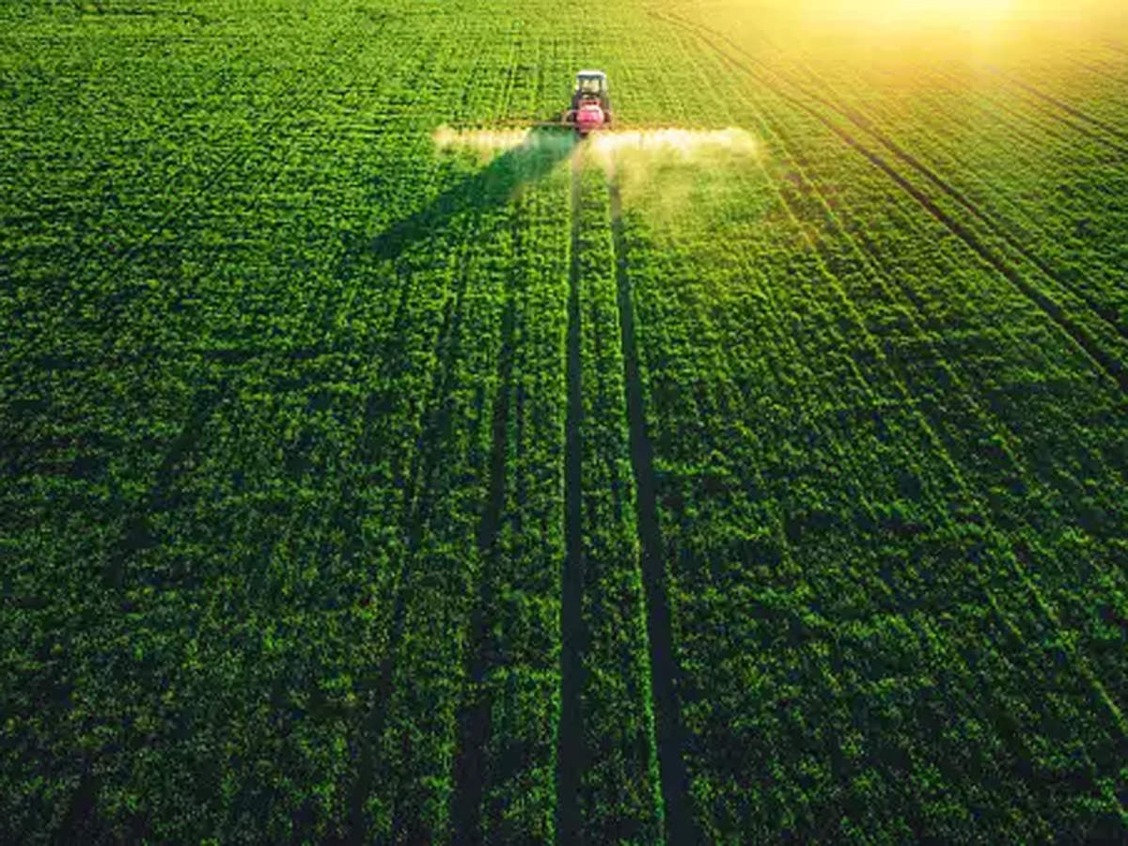
PROJECT 7: CROP PRODUCTION ANALYSIS IN INDIA Domain: Agriculture
PROJECT REPORT
Mentor:-
Saiprasad Kagne
Presented by:-
Priya Kumari

Slide 2
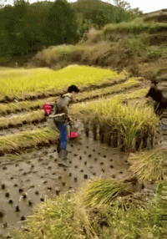
INTRODUCTION
Farmers and agribusinesses have to make innumerable decisions every day.
An essential issue for agricultural planning intention is the accurate yield estimation for the numerous crops involved in the planning.
Today, India ranks second worldwide in the farm output.
Agriculture is demographically the broadest economic sector.
Agriculture is a unique business crop production which is dependent on many climate and economy factors.
An accurate estimate of crop production and risk helps these companies in planning supply chain decision like production scheduling. Business such as seed, fertilizer, agrochemical and agricultural machinery industries plan production and marketing activities based on crop production estimates.

Slide 3
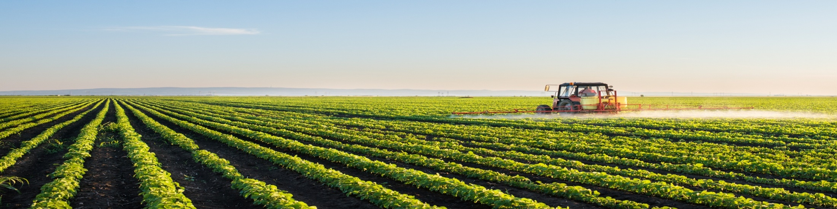
PROBLEM STATEMENT
The Agriculture domain- vital part of the overall supply chain.
Expected to highly evolve in the upcoming years.
This study presents a novel Business-to-Business collaboration platform from the agri-food sector perspective & aims to facilitate the collaboration of numerous stakeholders belonging to associated business domains.

Slide 4
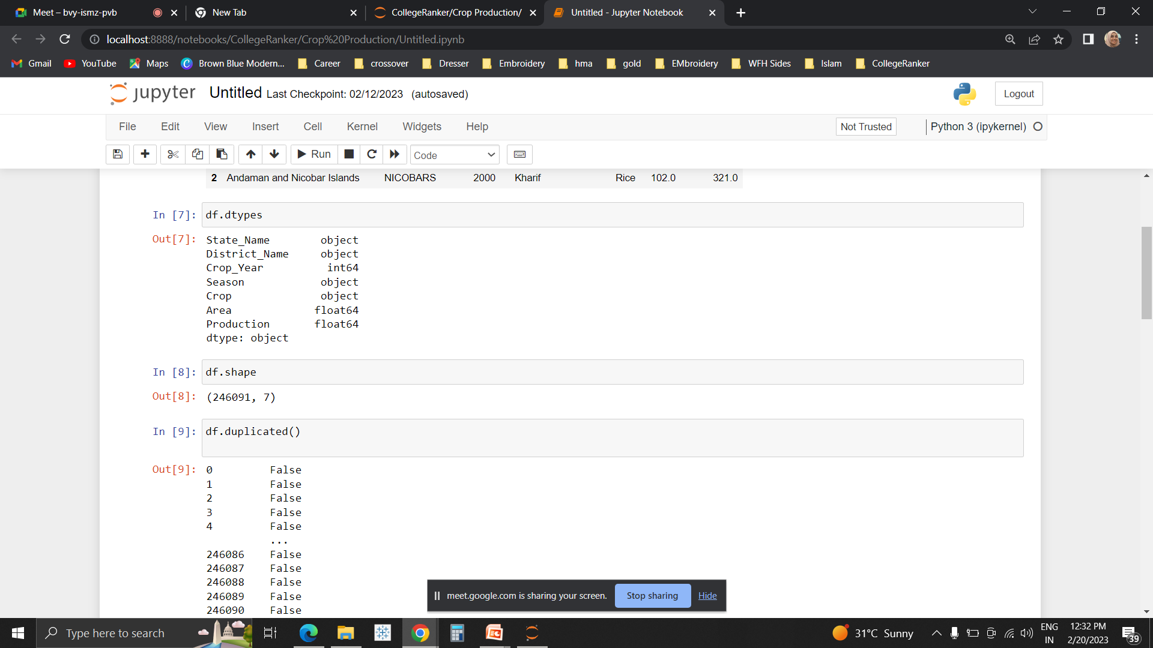


ANALYSIS
Dataset provides information on crop production in India ranging from several 1997-2015.
Based on the Information the ultimate goal would be to predict crop production and find important insights highlighting key indicators and metrics that influence crop production.
Approach:
Python: Used for Data Cleaning
Tableau: For Visualization.
Based on the findings, a story was created.
For better understanding, the results were displayed on 3 dashboards of the story, listed as:
Top-n Analysis
State-wise Analysis
Yearly Analysis
Attributes present in the data
Link to Dataset: https://docs.google.com/spreadsheets/d/1PF1PQ4qg4ySrtyOXiF6SFGX7P0Qfl_r/edit?rtpof=true&sd=true#gid=1443108996
Link to Python Notebook: https://colab.research.google.com/drive/1PU_S-anhlVvAl0xiU8IIG1XgK6M9crmK
Link to Tableau: https://public.tableau.com/app/profile/priya.kumari3667/viz/CropProductionAnalysisinIndia/Story1?publish=yes

Slide 5
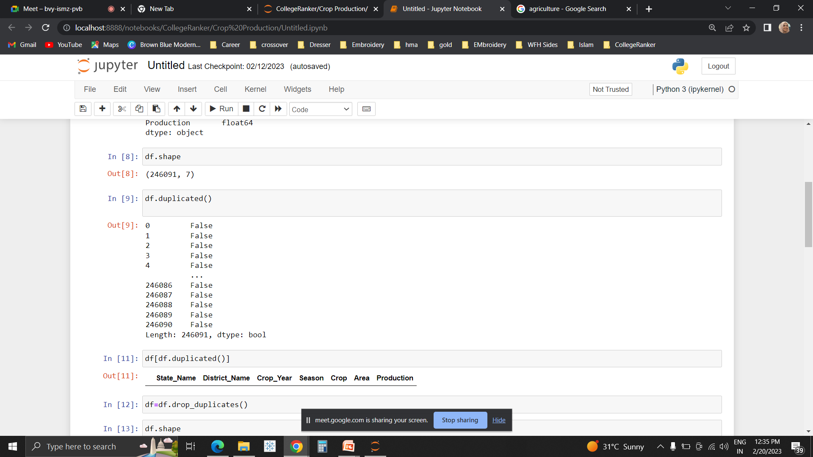
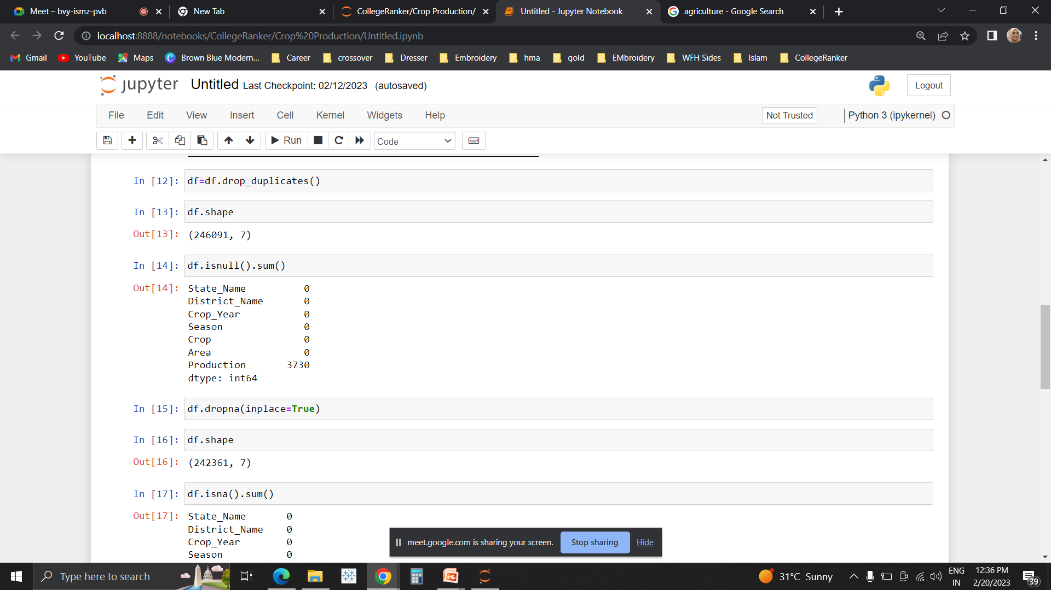
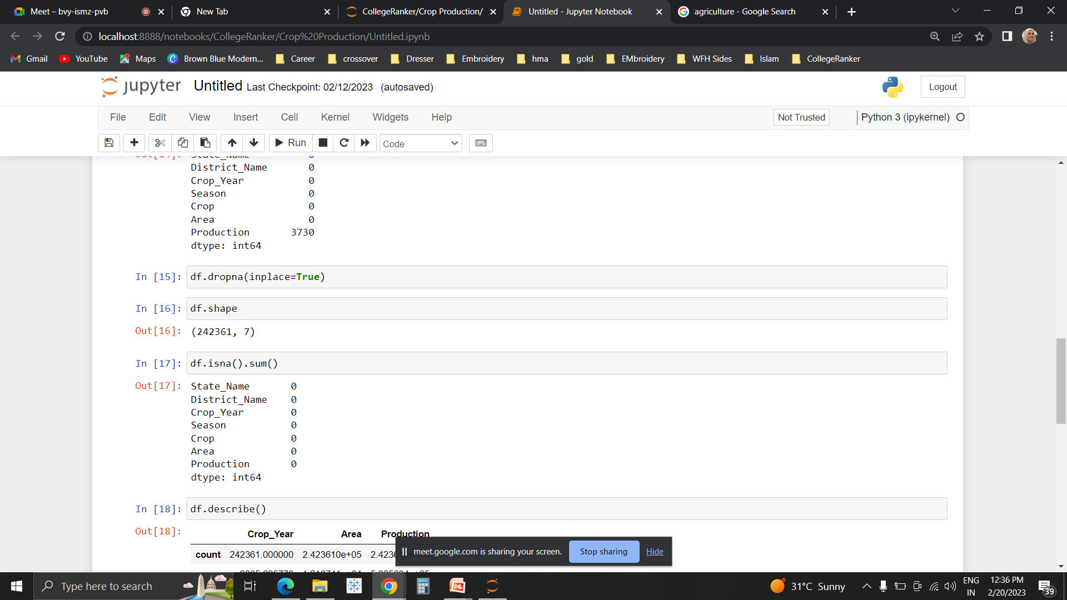
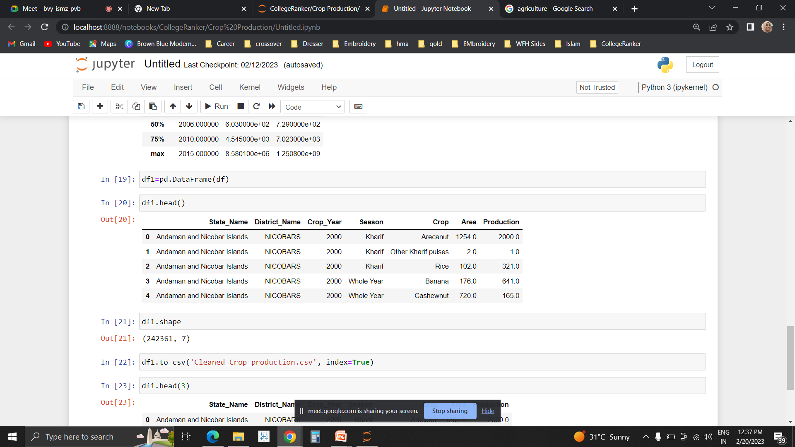
DATA CLEANING
Dataset was first read.
Missing and null values were found and removed using dropna( ) method. (3730 null values were removed, there were no duplicate values)
Cleaned file is downloaded for visual analysis in Tableau.

Slide 6
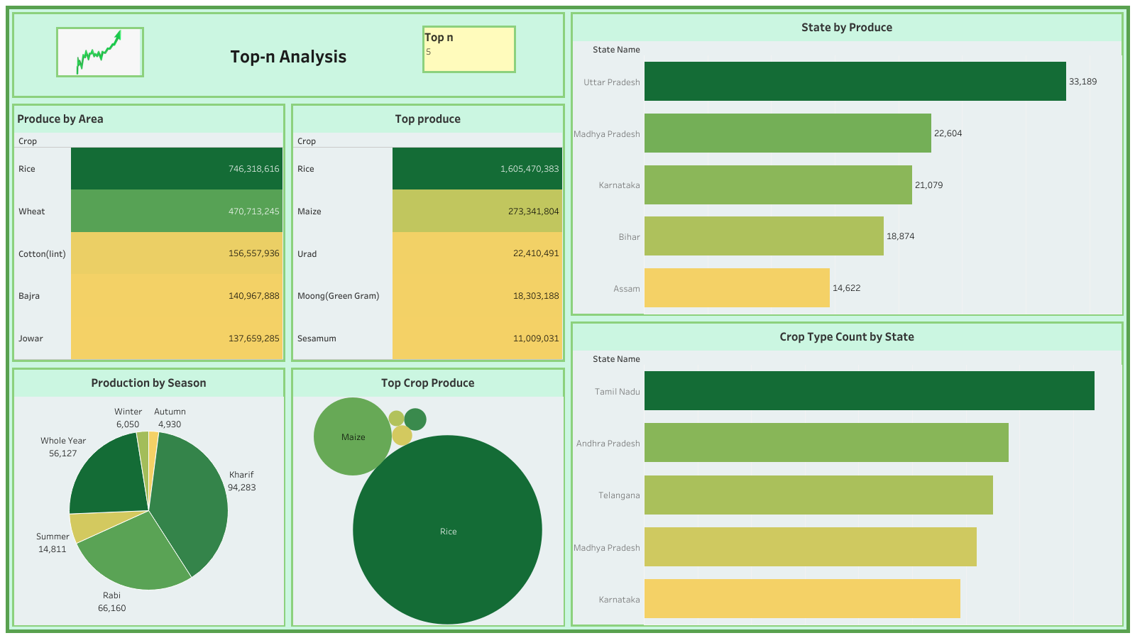

Slide 7
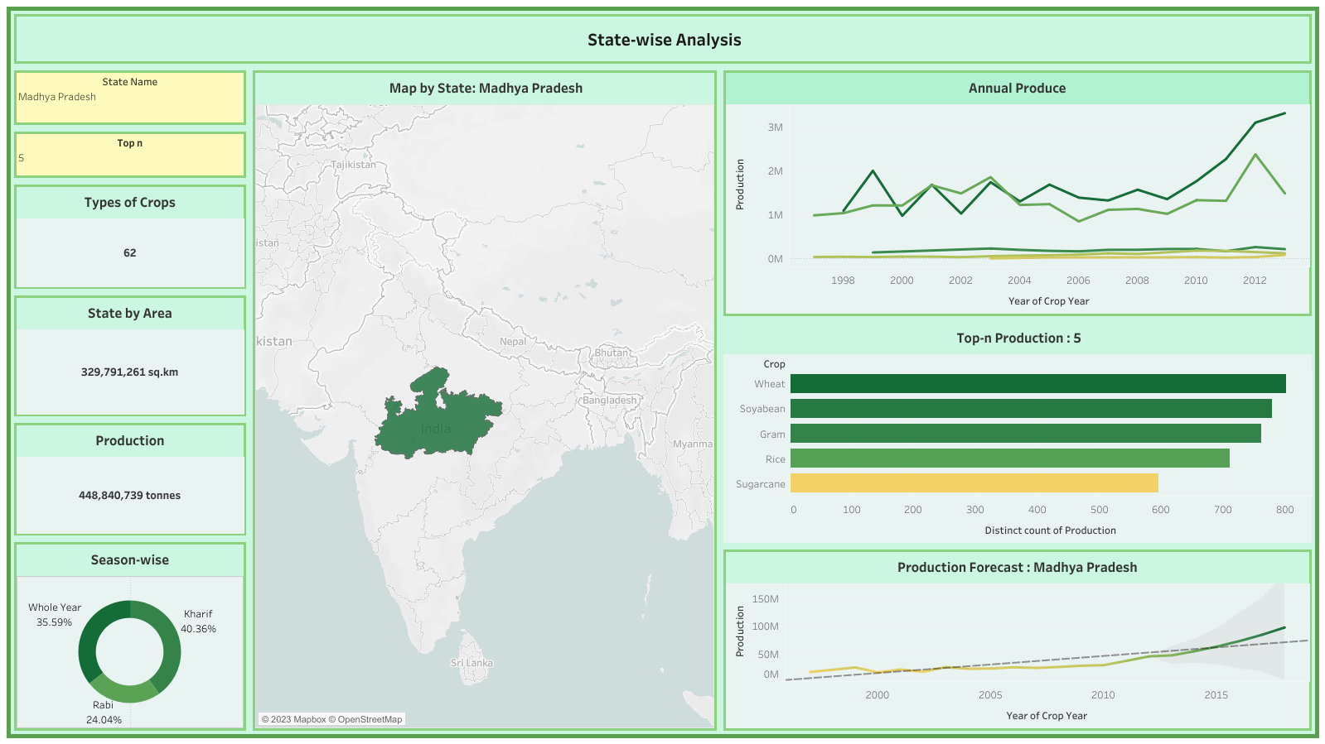

Slide 8
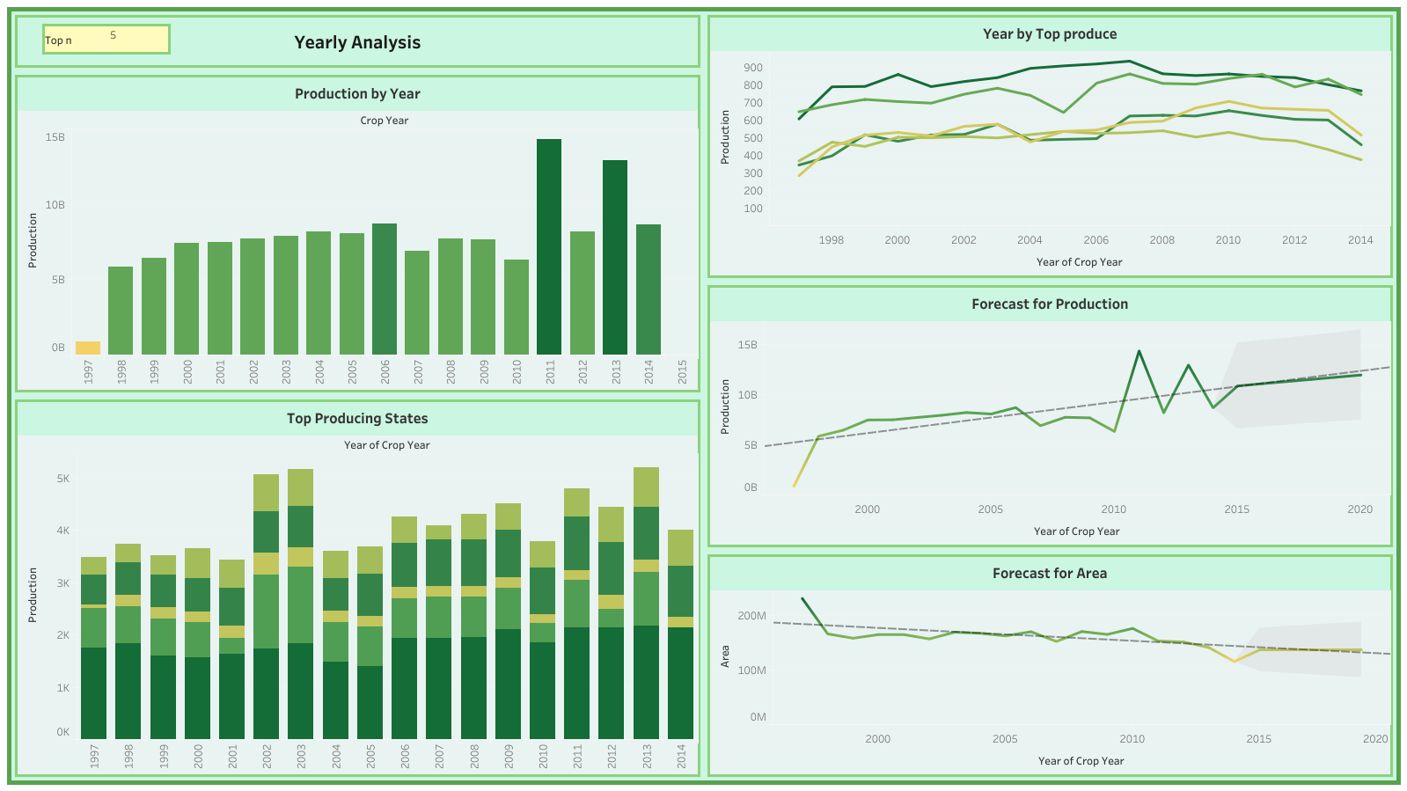

Slide 9

BENEFITS TO OTHER BUSINESSES
Improve farming productivity and operations- Farmers can analyze weather conditions, temperature, water usage and soil conditions to make informed decisions on business choices -- like determining the most feasible crop choices that year or which hybrid seeds decreased waste.
In AgriTech- Cooperation between private farmers, big agricultural corporations, communities, and governments. Such cooperation can result in the wider promotion of agriculture and rural development, a reduction in poverty, and food security.
Stop migration of the labor force.
Reduce food waste- 20% to 30% of food is wasted today at various stages of the supply chain.

Slide 10
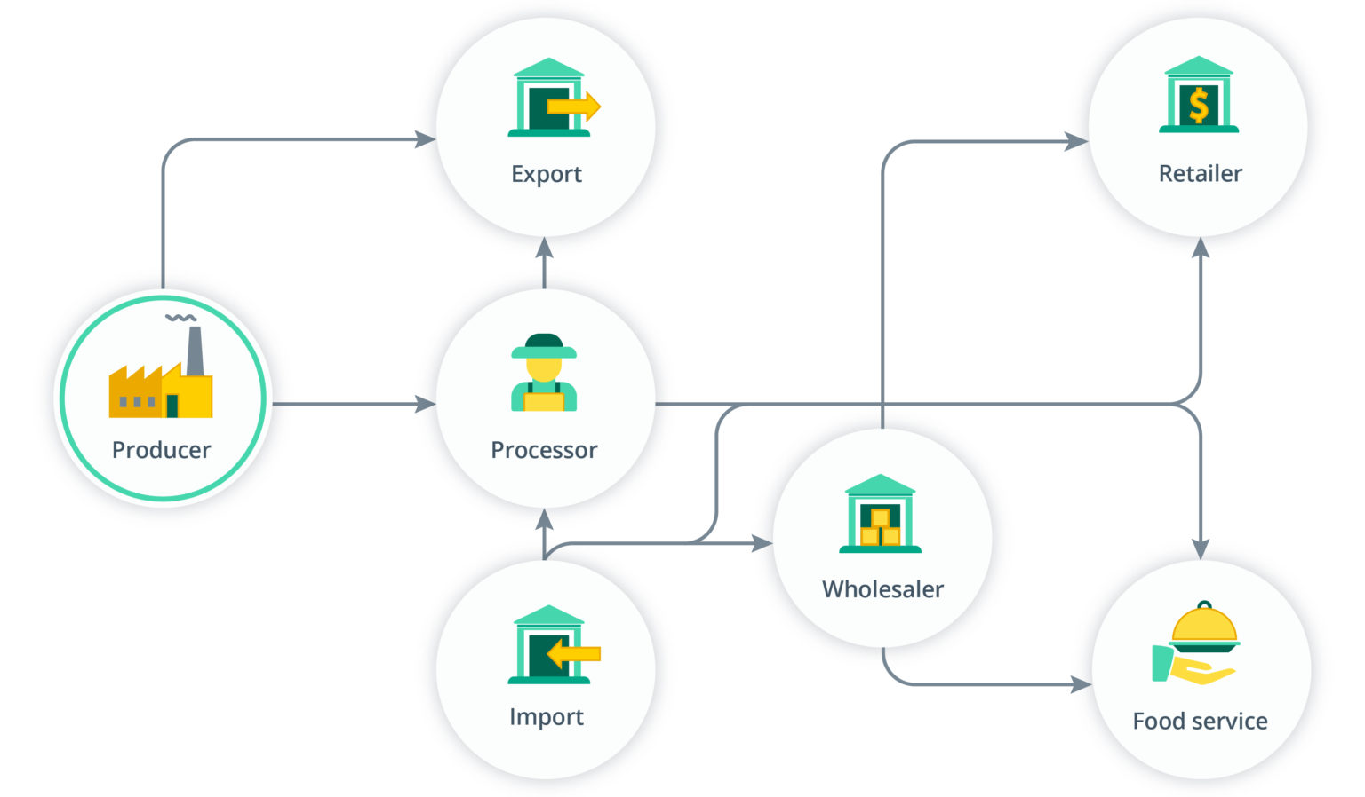
B2B SUPPLY CHAIN

Slide 11
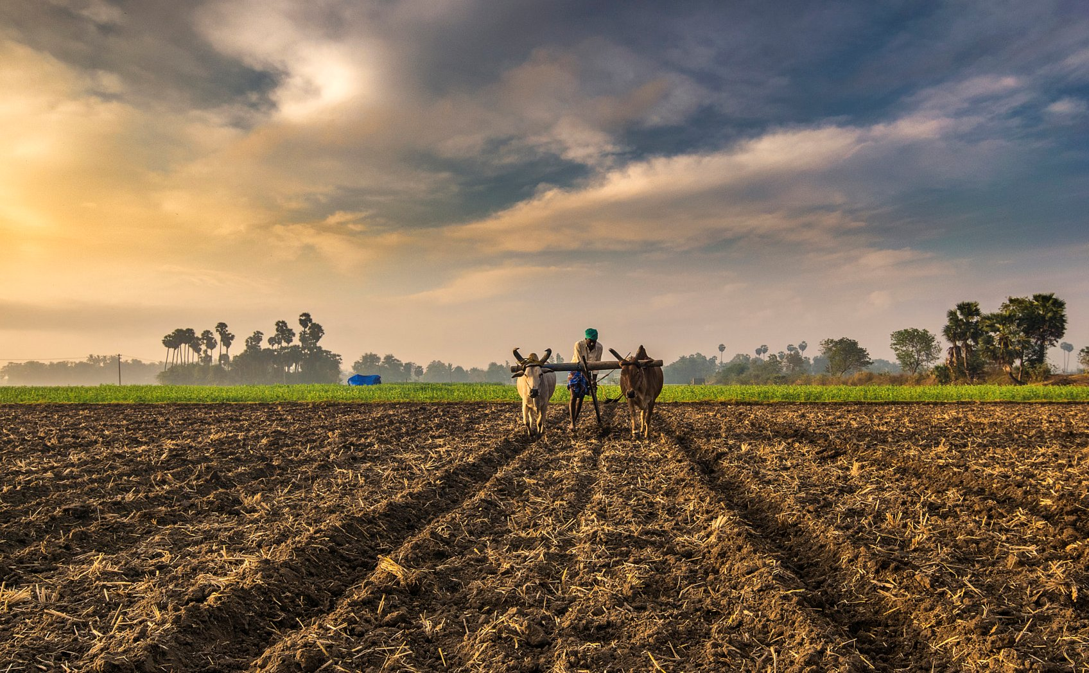
THANK YOU!

